Slide 1

Scientific Method: Station Rotation ☺
There are 9 stations your partner or group will be visiting.
Each pair / group will be turning in 1 answer sheet. Write names, date & period
Write the name of the station & the answers in complete sentences! Do not write the questions!
Make sure each person in your pair / group is answering at least 1 question per station

Slide 2
Station Rotation: Scientific Method
Station 1: Patty Power
Station 2: Slimotosis
Station 3: Marshmallow Muscles
Station 4: Microwave Miracle
Station 5: Mary’s Shirt Solution
Station 6: Ivy Plant Conditions
Station 7: Make My Garden Grow
Station 8: Unpopped Kernels
Station 9: Mice & Growth
P 4, 5 & 6- 3rotations,

Slide 3

Mythbusters!!!
https://www.youtube.com/watch?v=HtbJbi6Sswg
Running in rain = dryer?
https://www.youtube.com/watch?v=wFFslAjUyj4
Water torture
In sci. ntbk- ntbk check

Slide 4

Date: Friday, Aug. 1st
Q1 WK2 D5
Scientific Method Quiz

Slide 5

Making an Experiment:
Worksheet
Homework
Notes:
Pg. 1: Read scenario out loud, let students fill out independently; show under doc. Camera have students put answers on board.
Pg. 2: Read scenario out loud, let students fill out independently; show under doc. Camera have students put answers on board.

Slide 6
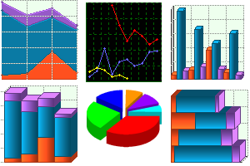
Q1 WK3 D1
Data Tables
&
Graphs

Slide 7
WHAT is a…
Data Table?

Slide 8
A data table is…
A chart that lets you organize information in rows and columns of CELLS.
Column
A
B
C
Row
1
Dogs
Cats
2
Girls
12
15
3
Boys
7
12
4
Total
19
27

Slide 9
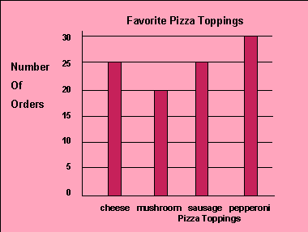
Data Analysis
Understanding how to read a data table will allow you to present and explain your findings through a graph!
Graphs are a great way to capture and display finings, information & data

Slide 10
Three types of graphs...
Pie
Bar
Line

Slide 11
Pie graphs
These are used to graph data in percentage form out of a whole.
For example:
The percentage of blue, brown, red M & M’s in a whole bag
Pie

Slide 12
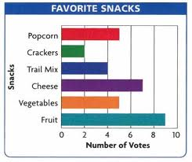
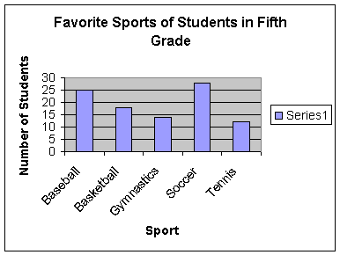
Bar Graphs
Bar graphs are best for showing comparisons between groups or categories or charting “chunks” of information.
Example: How many people are in each class throughout the 7 class periods of a day for a particular teacher.

Slide 13
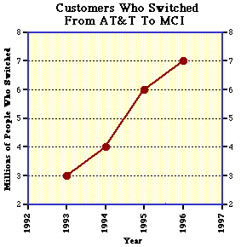
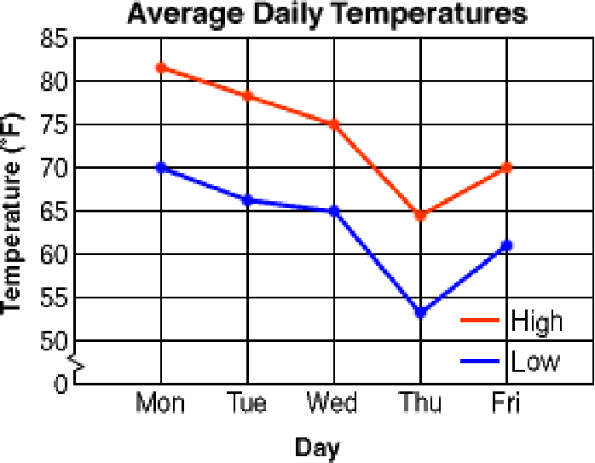
Line Graphs
Line graphs are best for displaying data or information that changes continuously over time
Example: The temperature of a mixture over a fifteen-minute period.

Slide 14
Parts of a Graph
A graph contains five major parts:
1. Title
2. The independent variable
3. The dependent variable
4. The scales for each variable
5. A legend

Slide 15
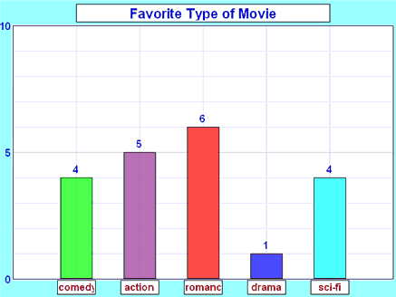
The Title…
The title depicts what the graph is about. By reading the title, the reader should understand the purpose of the graph. It should be a concise statement placed above the graph.

Slide 16
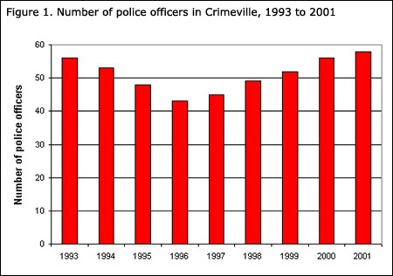
Independent Variable = X axis
(a.k.a. manipulated variable)
The INDEPENDENT VARIABLE (manipulated variable): is the variable that can be controlled by the experimenter. IV usually includes time (dates, minutes, hours, etc.), depth (feet, meters), and temperature (Celsius).
This variable is placed on the X axis (horizontal axis).
Years = IV

Slide 17
Dependent Variable
(a.k.a. Responding Variable)
The DEPENDENT VARIABLE (responding variable): is the result of what happens because of the independent variable.
Example: How many oxygen bubbles are produced by a plant located five meters below the surface of the water?
The oxygen bubbles are dependent on the depth of the water. This variable is placed on the Y-axis or vertical axis.
DV

Slide 18
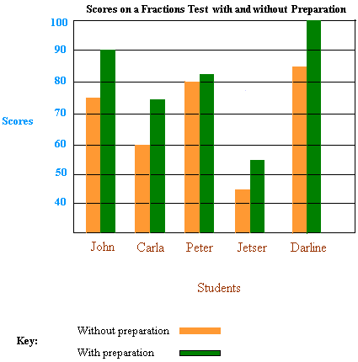
Scales
The scales for each variable: In constructing a graph one needs to know where to plot the points representing the data. However, it shouldn’t be so tiny that I need a magnifying glass to see it either!
The scales should start with 0 and climb based on intervals such as: multiples of 2, 5, 10, 20, 25, 50, or 100.
The scale of numbers will be dictated by your data values.
Scales are needed for both IV & DV

Slide 19
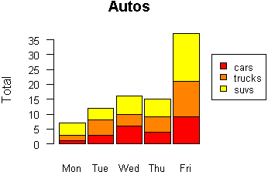
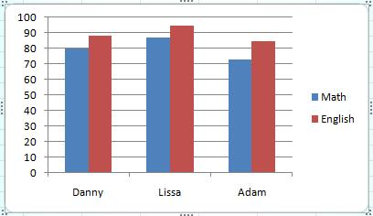
Legend
The LEGEND: is a short description concerning the graph's data. It should be short and concise and placed under the graph or to the side.

Slide 20
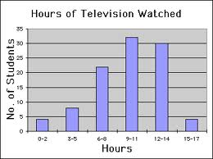
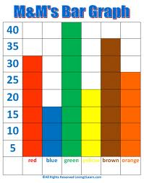
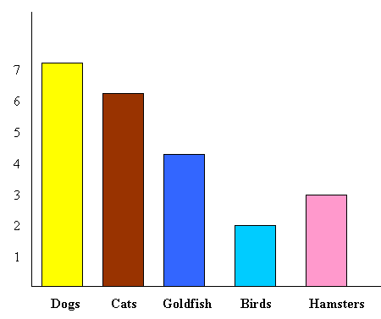
Is anything missing?

Slide 21
Graphing: Station Rotation
Station 1: What type of graph is it?
Station 2: Labeling Axes
Station 3: Plotting Points
Station 4: Creating Titles
Station 5: Bar & Line Graphs- Part I
Station 6: Bar & Line Graphs- Part II
When you visit a station,
complete 1 paper per station!

Slide 22

Data Analysis Practice
Homework!

Slide 23
Date: Tues, July 31st
Q1 WK2 D2
THEORY
It is the dominant explanation of an observed phenomena.
It’s an explanatory story that’s supported by mountains of evidence & provides connections among several ideas.
It is known to the scientific community & the world at large.

Slide 24

Pure Science vs.
Applied Science
What’s the
difference???

Slide 25

APPLIED SCIENCE
Doing research to make discoveries that will have an immediate effect in people’s lives.
  EXAMPLE: Scientists studying the structure of the AIDS virus or the “Bird Flu” virus are contributing to efforts to make vaccines.

Slide 26

PURE SCIENCE
Doing research because they are curious about how the natural world works.
  EXAMPLE: The “STRING THEORY”= explains that the universe is made up of 10 or even 26 dimensions.

Slide 27
Analyzing Experimental Design
Q1 WK4 D2
Biology Polar Bear book, pg. 20. read the background
Copy the data table
Answer questions #1-4
Make a graph! Explain WHY you used that graph
Scientific Method
summary activity

Slide 28
Section 3 Review- pg. 20
Q1 WK4 D2
Pg. 20: Biology Polar Bear book
Write the question and the answer
Answer #’s 1-3
Scientific Method
summary activity

Slide 29

October Sky- Scientific Method
Take out a lined sheet of paper
Write “October Sky- Scientific Method” on the top along with your name, date & period
Leaving ~5 lines in between each step, list all 6 steps to the scientific method
  Use your notes to list the steps!!!
While watching the movie, provide examples of how the friends used the scientific method process to build rockets ☺

Slide 30

You can now officially complete experimental processes and answer questions about them.
YEAH!!!!!

Slide 31

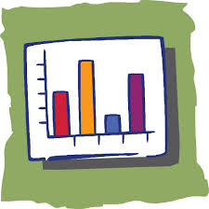
Interpreting Graphs worksheet
DUE MONDAY!

